Slide 1
More on single-view geometry

Slide 2
Action of projective camera on planes
Choose the world coordinate frome so that X-Y plane corresponds to a plane π in the scene such that points
In the scene plane have zero Z coordinate.
The map between the point on plane π and its image is a general planar homography: x = H x_{π} ; H is 3x3
The most general transformation that can occur between
a scene plane and an image plane under perspective
imaging is a plane projective transformation

Slide 3
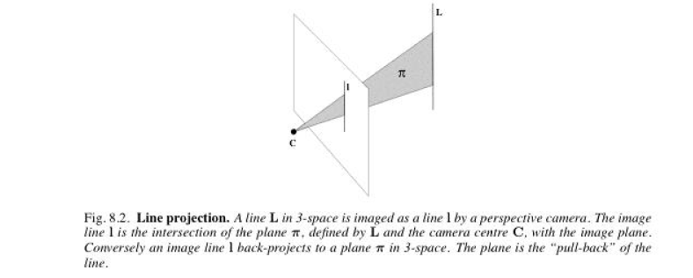
Action of projective camera on lines
forward projection
A line in 3D space projects to a line in the image.
Suppose A and B are points in space with their projections being a, and b under P; Then a point on a line that joins A and B i.e. X(μ) = A + μ B
Is the point:
Which is on the line joining a and b.
Set of points in space mapping to line l via the camera matrix P is plane P^{T} l
Line and camera center define a plane; image of the line is
the intersection of this plane with image plane.
back-projection

Slide 4
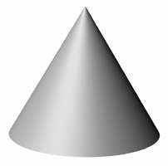
Action of projective camera on conics
Conic C backprojects to a cone
back-projection to cone

Slide 5
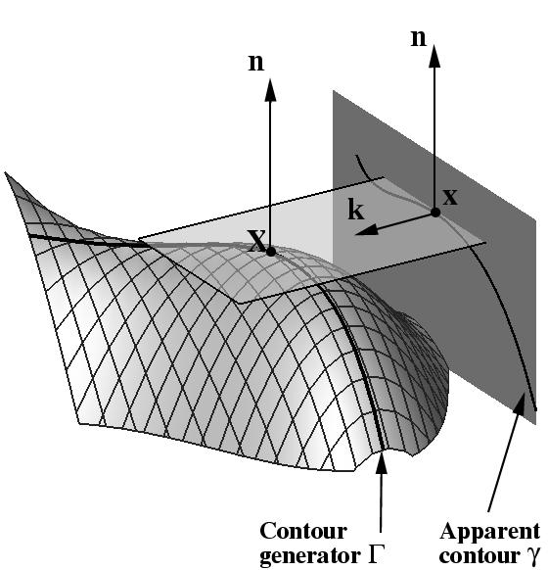
Images of smooth surfaces
Image outline of a smooth surface results from surface points at which the imaging rays are tangent to the surface
The contour generator Γ is the set of points X on S at which rays are tangent to the surface. The corresponding apparent contour γ is the set of points x which are the image of X, i.e. γ is the image of Γ
The contour generator Γ depends only on position of projection center and not on image plane; γ depends also on rest of P
For parallel projection with direction k: all rays parallel to k which are tangent to surface S, form a “cylinder” of tangent rays;
Curve along which the “cylinder” meets the image plane is the apparent contour; Both the contour generator and apparent contour depend on k.
The apparent contour γ is also called “outline or Profile”.

Slide 6
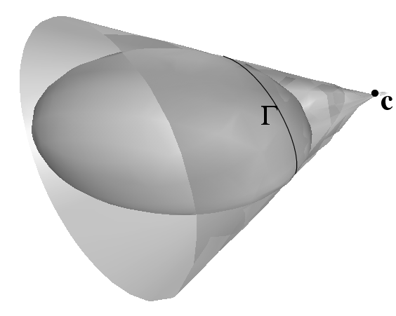
Action of projective camera on quadrics
back-projection to cone
Under camera matrix P, the apparent contour of a Quadric Q is the conic C given by:
Outline curve of a quadric are all points where backprojected rays are
tangent to the quadric surface
Summary: apparent contour of a quadric is a conic. The contour generator is also a conic
The plane of Γ for a quadric Q and camera center C is given by Π=QC

Slide 7
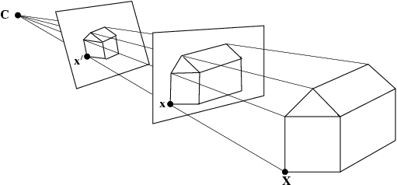
The importance of the camera center
Object in 3 space and camera center define “set of rays”
An image is obtained by intersecting these rays with a plane
Images obtained with the same camera center may be mapped to one another by a plane projective transformation
Assume two cameras
Same camera center
This is the 3x3 planar
Homography relating x and x’

Slide 8
Moving the image plane (zooming)
Changing the focal length, can be approximated as displacement of image plane along principal axis
x and x’ are images of a point X before and after zooming respectively
x’ = H x where
Assume only focal length
Is different between K and K’
Conclusion: the effect of zooming by a factor of k is to multiply the Calibration matrix
K on the right by diag(k,k,1)

Slide 9
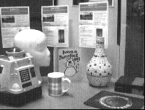
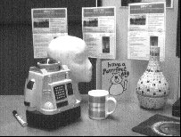
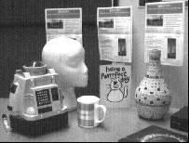
Camera rotation
Pure rotation about camera center.
x and x’ image of a point X before and after rotation.
^{x’= H x where:}
H is called conjugate rotation: same eigen values, up to a scale factor, μ, of the rotation
Matrix: ; So, phase of complex eigenvalues of H can be used to find rotation.
Can also be shown that the eigenvector of H corresponding to the real eignenvalue is the vanishing point of the rotation axis
click on 4 sets of correspondence
between A and B to determine H;
theta = 4.66 degrees.
vanishing point of rotation axis
is (0,1,0)^{T} , i.e. virtually at infinity in
the y direction; so rotation axis is
parallel to y direction
B A C

Slide 10
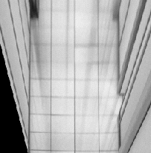
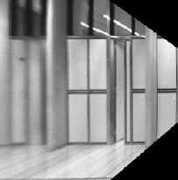
Application: generate synthetic view
In fronto parallel view (1): a rectangle is imaged as a rectangle; (2) world and image rectangle have same aspect ratio.
Approach: synthesize fronto parallel view by warping an image with the homography that maps a rectangle imaged as a quadrilateral to a rectangle with the correct aspect ratio.
Compute the homography H that warps the image quadrilateral to a rectangle with the known aspect ratio
Projectively warp the source image with this homography

Slide 11
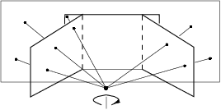
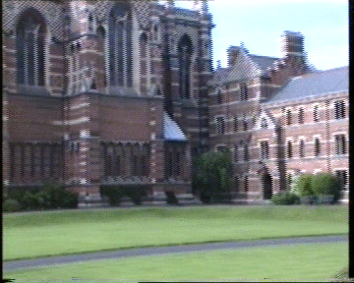
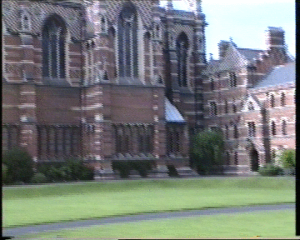
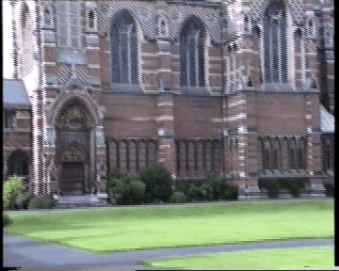
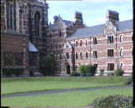
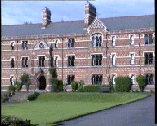
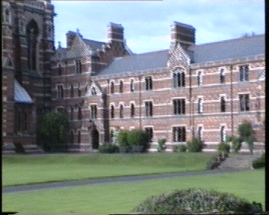
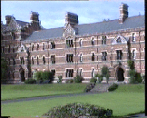
Planar homography mosaicing

Slide 12
close-up: interlacing
can be important problem!

Slide 13
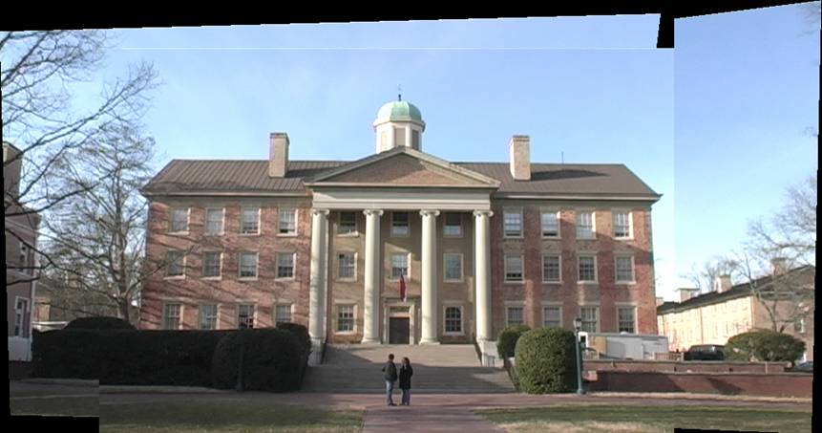
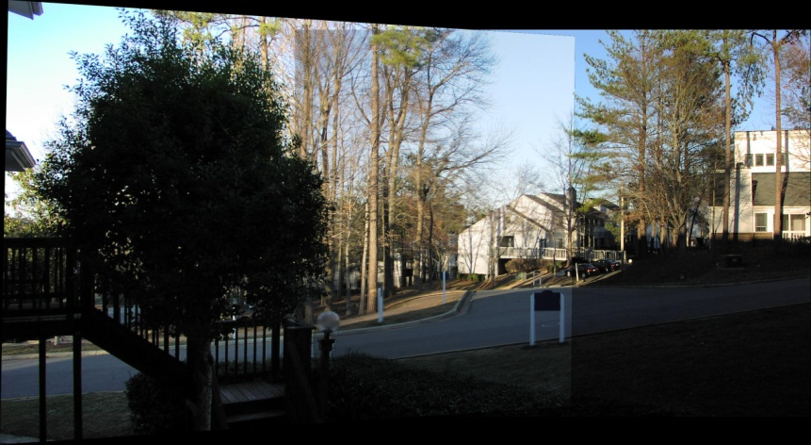
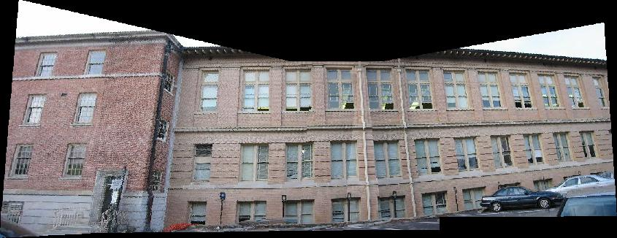
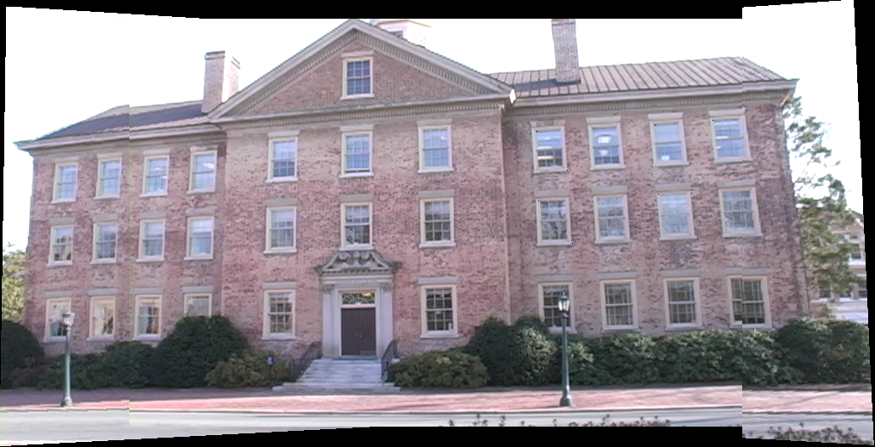
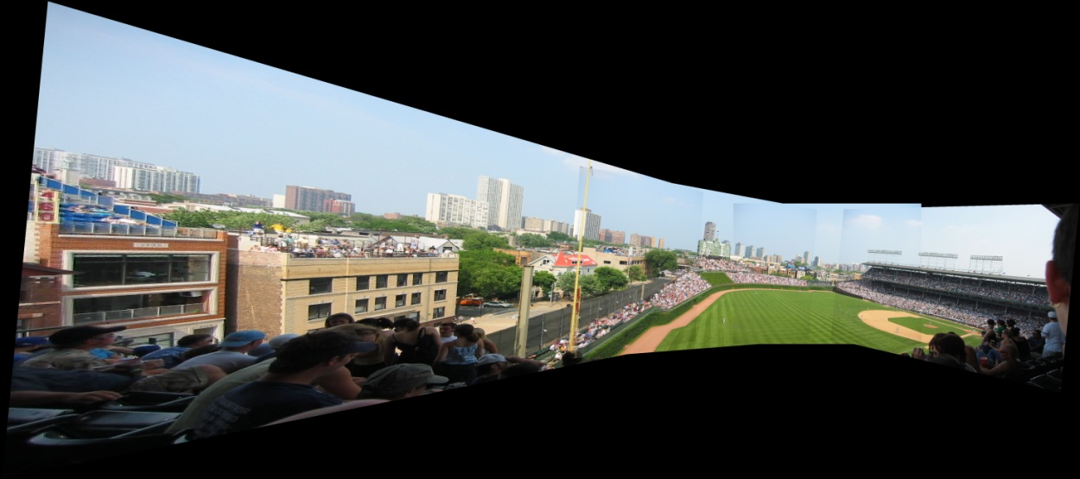
Planar homography mosaicing
more examples

Slide 14
Projective (reduced) notation
Can be shown that if canonical projective coordinates are chosen for world and image points, i.e.
Then, camera matrix
Satisfies x_{i} = Px_{i} which means that the camera center is given by
This form of P is known as reduced camera matrix;
Completely specified by the 3 degrees of freedom of camera center C
Shows that all images acquired by cameras with the same camera center are projectively equivalent
Camera has been reduced to its essence: a projective device whose action is to map P³ to P² with only the
position of the camera center affecting the results.

Slide 15
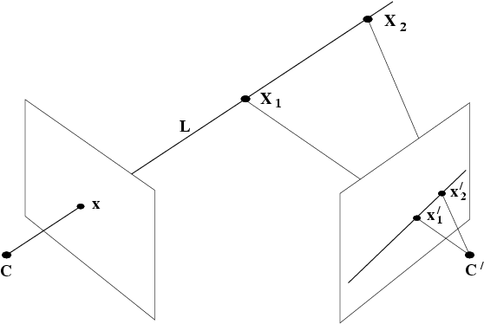
Moving the camera center
If C is fixed, but camera rotates or zooms, transformation of image only depends on the image plane motion NOT on 3D space structure
If C moves, map between images depends on 3 space structure it is looking at:
Important special case of 3-space structure: all scene points are co-planar:
2 images with motion parallax (camera center moving) are still related by planar homography
motion parallax
epipolar line

Slide 16
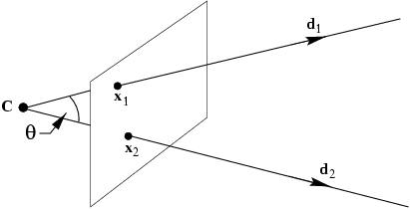
What does calibration give?
Image point x backprojects to a ray defined by x and camera center ➔ calibration relates image point to the ray’s direction
Points on a ray X = λ d with d being a direction, map to a point on the image plane x given by:
Get d from x by :
Angle between two rays with directions d₁ and d₂ corresponding to x₁ and x₂
if K is known, can measure angle between rays from their image points.
A camera for which K is known is called calibrated;
A calibrated camera is a direction sensor able to measure the direction of rays like a 2D protractor
θ
An image line l defines a plane through the camera center with normal n=K^{T}l measured in the camera’s Euclidean frame

Slide 17
The image of the absolute conic
Image of the points on the plane at infinity i.e. X∞ = ( d ^{T} , 0)^{T} is given by:
independent of camera center
mapping between π∞ to an image is given by the planar homogaphy x=Hd, with H=KR
Absolute conic lies on π∞ . ➔ image of the absolute conic (IAC)
IAC depends only on intrinsics, not on camera orientation or position
angle between two rays: independent of projective coordinate frame of image
if x₁ and x₂ are image points corresponding to orthogonal direction then
Dual image of absolute Conic: DIAC=ω*=KK^{T}
ω ⇔ K: once ω is known, can find K via cheloski factorization
image of circular points are on ω
ω
ω

Slide 18
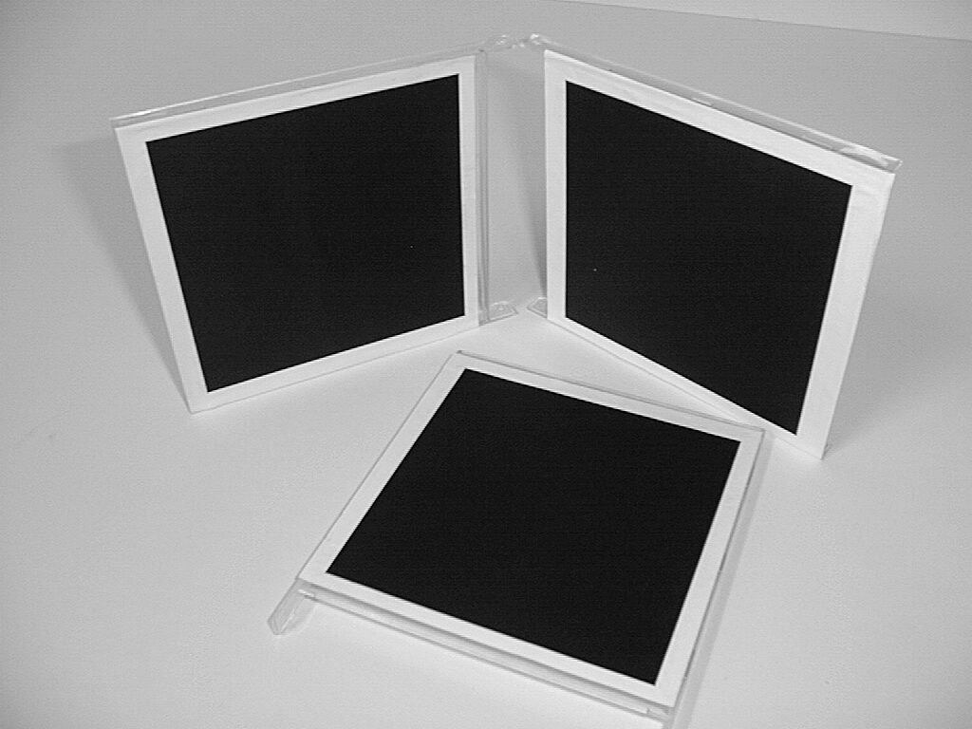
A simple calibration device to find K
compute H for each square ; H maps corners (0,0),(1,0),(0,1),(1,1) to their image points
alignment of the plane coordinate system with the square is a similarity transform and does not affect the position of circular points
compute the imaged circular points: H(1,±i,0)^{T} = h₁ ±i h₂ if H = [ h₁ h₂ h₃ ]
image of circular points are on ω.
fit a conic to 6 imaged circular points: If h₁ ±i h₂ lies on ω then (h₁ ±i h2)^{T} ω (h₁ ±i h₂ ) = 0
set the real part and the imaginary part to zero: two linear constraints in ω ➔ need 3 planes
Real h₁ ^{T} ω h₂ = 0 ; Imaginary: h₁ ^{T} ω h₁ = h₂ ^{T} ω h₂ ➔ linear in ω
compute K from ω through cholesky factorization
(= Zhang’s calibration method)

Slide 19
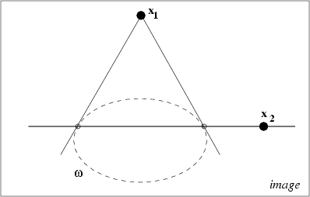
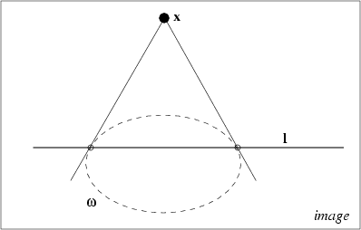
Orthogonality = pole-polar w.r.t. IAC

